Slide 1
Toronto neighbourhoods
Potential for gym opening

Slide 2
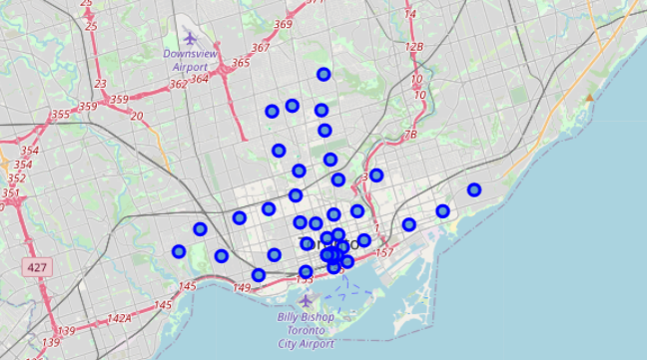
Neighbourhoods in Toronto
Per the investor’s requirements, we looked into potential places in Toronto suitable for opening of a gym.
We’ve taken into account number of neughbourhoods in Toronto, population of existing sport areas (including but not limited to parks, gyms, fitness studio) and number of existing gyms.
There are 39 neighbourhoods in Toronto in total.

Slide 3
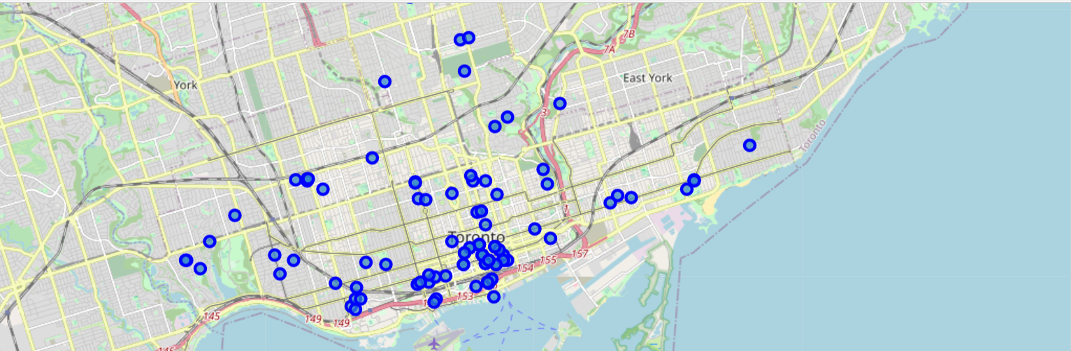
Neighbourhoods with sport areas
There are currently 111 sport areas in Toronto, located in 35 neighbourhoods.

Slide 4
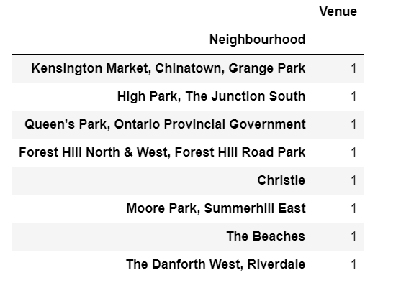
Neighbourhoods with 1 sport area
8 neighbourghoods have only 1 sport area.

Slide 5
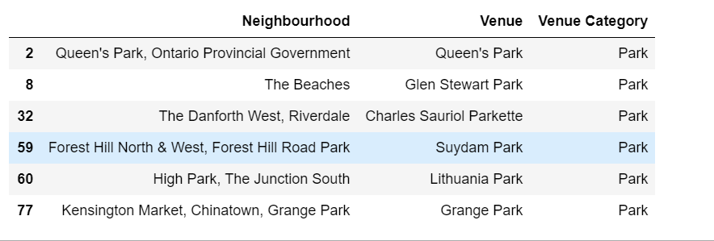
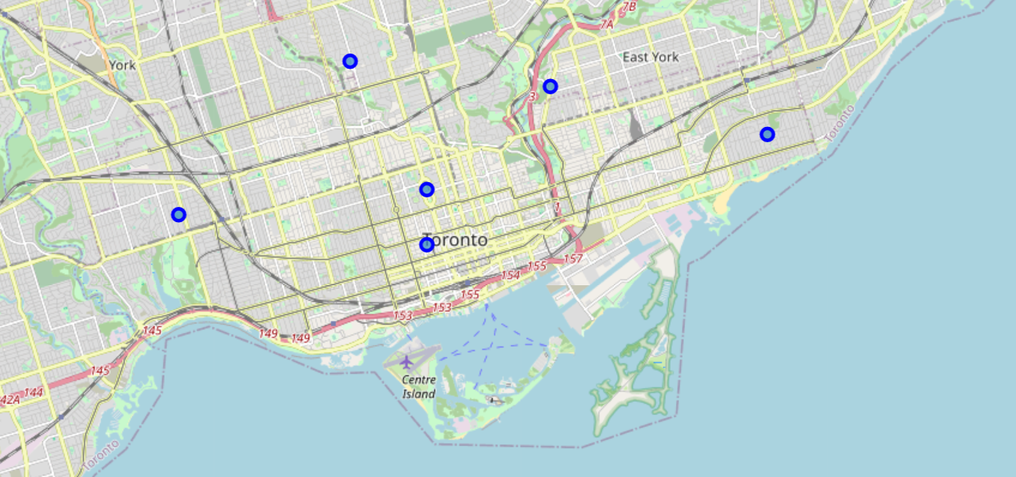
Neighbourhoods without gyms
Out of 8 neighbourhoods, 6 have no gyms in their area. As such, our recommendation is to open a new gym in one of the below neighbourhoods.

